Slide 1
Marginal deformations in OSFT
Matěj Kudrna
Institute of Physics of the Czech Academy of Sciences
String Field Theory Prague 2022

Slide 2
Introduction
There are many theories with continuous families of boundary states/D-branes
  For example, D-branes in flat space with varying positions or Wilson lines
In a boundary conformal field theory, they are related by deformation of the boundary action
where is boundary marginal parameter and J is a weight 1 boundary field
We would like to describe such families of boundary states using open string field theory
Should be possible because of background independence of OSFT
We use the level truncation approach in Siegel gauge

Slide 3
We parametrize OSFT solutions by the coefficient in front of the marginal field
Marginal deformations of the perturbative vacuum does not depend on the background, but only the OPE of the marginal field
⇒ marginal solutions are universal
We take the OPE to be
The two marginal parameters can be related using gauge invariant observables
Gauge observables depend on the background CFT
The relation between marginal parameters is the same within numerical errors

Slide 4
We will discuss results in two different models
The universal marginal solution for cos X deformations in free boson theory using three different approaches
  Perturbative approach
  Marginal approach
  Tachyon approach
Marginal deformations of nontrivial solutions in the SU(2)_{k} WZW model
  Do not preserve D-brane energy
  Non-universal

Slide 5
References
Free boson in the level truncation approach
  arXiv: 0007153
  arXiv: 1207.3335
  arXiv: 1601.04046
  arXiv: 2101.07678
SU(2)_{k} WZW model
  arXiv: 2112.12213
  Work in progress
More references
  arXiv: 0008227, 0403200, 1306.6532, 0701249, 0701248, 0704.2222, 0707.4472, 1009.6185, 1209.4712, 1402.3546, 1506.03723, 1702.06489

Slide 6
Free boson setting
We consider free boson theory on the self-dual radius R=1
  Neumann intitial boundary conditions
Well-understood theory, dual to SU(2)₁ WZW model
Simple OSFT, we can go to high level and get good precision
We consider cos X marginal deformations
  Interpolate between Neumann and Dirichlet boundary conditions
  Similar to lump solutions

Slide 7
We compute the following observables:
The energy
  It is proportional to D-brane mass/boundary state g-function and it should not depend on the marginal parameter
Ellwood invariants
  Defined using on-shell bulk operators
  They should reproduce boundary state components

Slide 8
We consider the following invariants
The expected values are given by goniometric functions

Slide 9
Perturbative approach
For small , the string field can be written as a power series in the marginal parameter
The equations of motion can be solved order by order
The formal analytic solution is
where
Evaluation of the solution gets more complicated with growing order

Slide 10
This solution is useful for determining relation between the marginal parameters perturbatively
We expand the marginal parameter as
Similar expansion for observables and their expected values
Comparison leads to formulas for the coefficients a_{i}

Slide 11
We computed level 22 solution up to order 8, which gives us the first 4 coefficients
The two parameters agree in the first order
Good agreement between different invariants
⇒ The solution is consistent
Agrees with coefficients obtained from the marginal approach

Slide 12
The solution has a finite radius of convergence
Probably corresponds to length of the branch in the marginal approach
Example: level 6, up to order 400

Slide 13
Radius of convergence can be estimated as , where f_{n} are coefficients of expansion of some quantity
  Converges close to branch length up to level 5
  Chaotic from level 6 (needs very high order?)

Slide 14
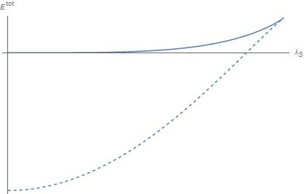
Marginal approach
Started by Sen and Zwiebach
Solutions parameterized by coefficient of the marginal field
The corresponding equation is removed
Symmetric with respect to
Two branches connected to the perturbative and tachyon vacuum
  Marginal branch
  Vaccum branch (unphysical)
Numerical solution up to level 18
  Good precision

Slide 15
The marginal branch has final length
  Ends by meeting the vacuum branch
  Only complex solutions for higher
Most of the branch describes marginally deformed boundary states
  Observables agree well with the expected values
  from various invariants are consistent
  Missing equations are asymptotically satisfied
Towards the end looses precision
  Probably goes off-shell

Slide 16
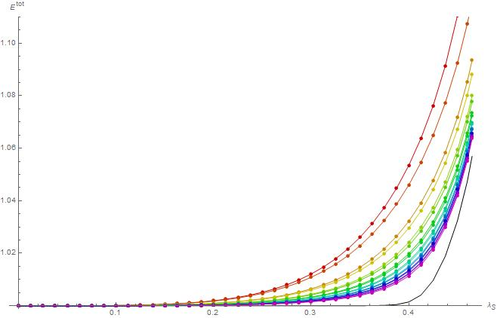
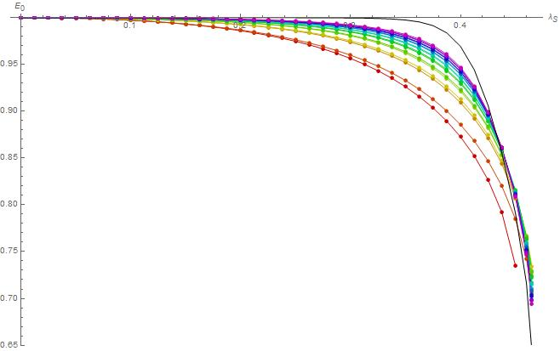
Plots of energy and E₀ invariant

Slide 17
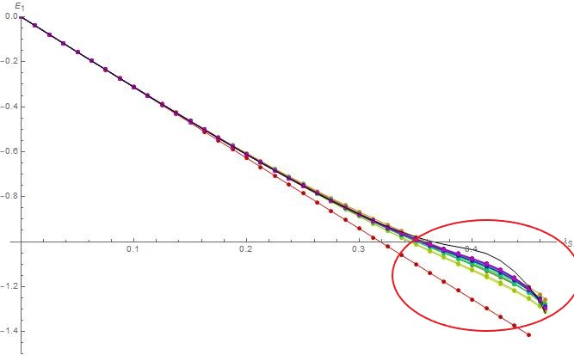
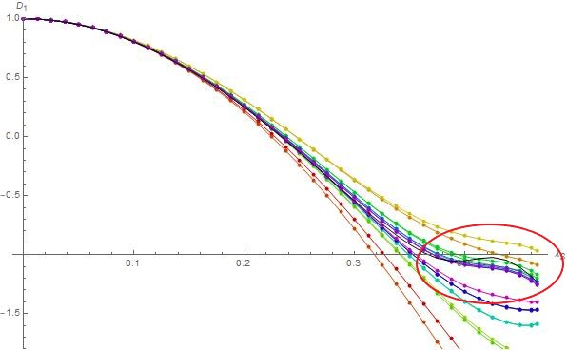
Plots of E₁ and D₁ invariants
  Go outside the allowed range

Slide 18
Probably goes off-shell towards the end
  Does not satisfy eqaution for the marginal field
  Does not satisfy out-of Siegel equations
  Gauge invariants do not correspond to any boundary state
Difficult to determine the exact point where it ends
We will try further analysis using tachyon approach

Slide 19
Tachyon approach
Introduced in arXiv: 1601.04046
We parameterize marginal solutions by the zero momentum tachyon t
changes with level for given t
We remove the equation corresponding to the tachyon field
Should converge to the same solution as in the marginal approach
  Different at finite level
Covers more moduli space than the traditional approach

Slide 20
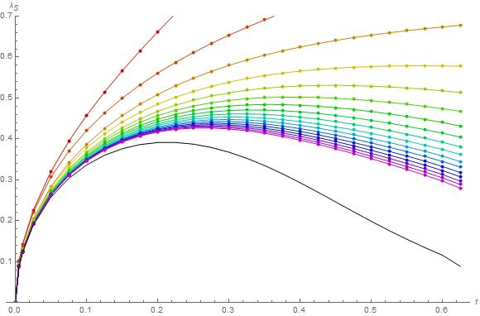
as function of t has maximum
Should be described by two branches in the marginal approach
The second branch has not been found yet not

Slide 21
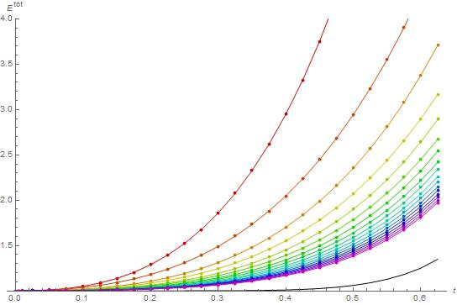
Gradually loses precision
Probably goes off-shell like in the marginal approach
More difficult to say where

Slide 22
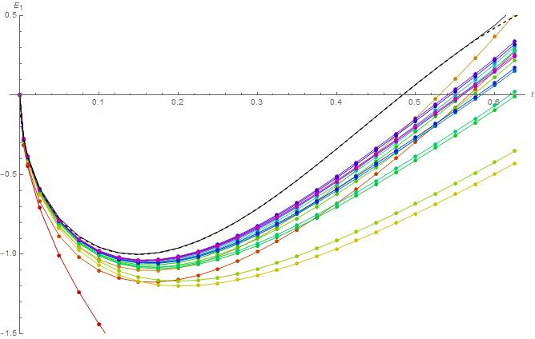
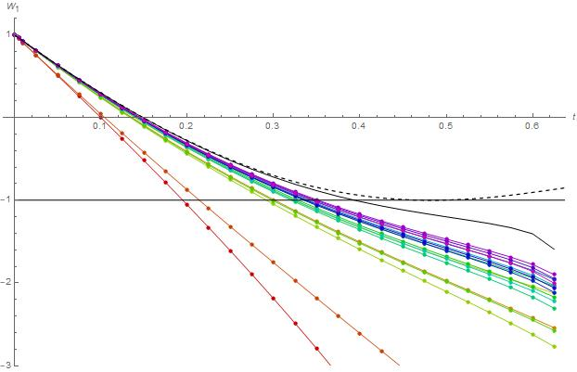
W₁ invariant suggests that it may become inconsistent around
t ~ 0.4

Slide 23
It covers Ditrichlet boundary conditions
The parameters agree quite well with prediction from lump solutions
Possibly covers Neumann boundary condition with Wilson line
May be off-shell at this point

Slide 24
Back to marginal approach
The tachyon approach gives us estimates for maximal
and for the Dirichlet point
The marginal approach should cover the Dirichlet boundary conditions
  Covers the fundamental part of moduli space
Wrong behavior after the Dirichlet point

Slide 25
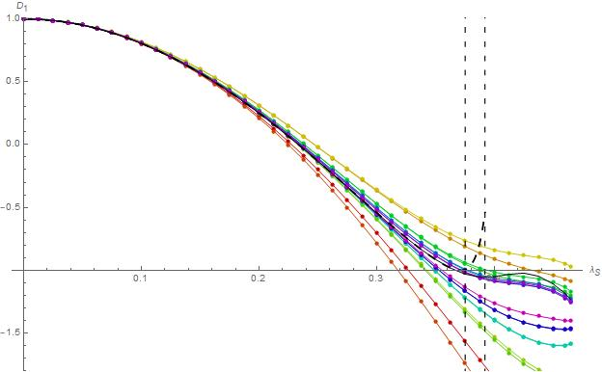
D₁ invariant

Slide 26
How to determine where the branch goes off-shell just from the marginal approach data?
Use error estimates of extrapolations
Consider the ratio of actual errors of extrapolations and their estimates
Random behavior in the first part of the branch
Grows quickly in the same area for many quantities
Gives a decent estimate where the branch goes off-shell

Slide 27
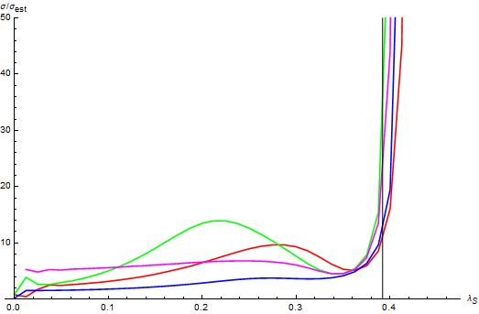

Slide 28
Relation between marginal parameters
Results for for analytic solution (arXiv:1506.03723)
  Depends on gauge
  Linear for small
  Has a maximum
  Goes to zero for
Does the numerical solution lead
to similar function?

Slide 29
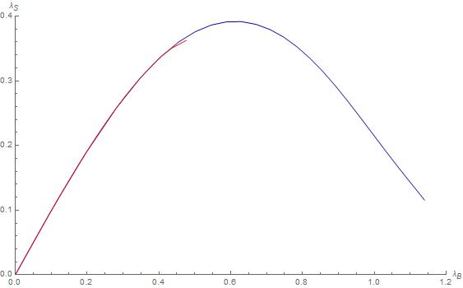
Several invariants that depend on
Computed by inversion of functions for the expected values
Different invariants give similar
results for most of the branch
Red: marginal approach
Blue: tachyon approach
  Almost the same functions
Similar to the analytic solution

Slide 30
Complex marginal deformations
The marginal parameter can be complex
  Generic complex solutions
  Almost real action
  Well-behaved even ouside
  radius of convergence of the
  perturbative solution
Especially nice for imaginary
  Real action
  The branch is much longer
  Invariants given by
  hypergeometric functions

Slide 31
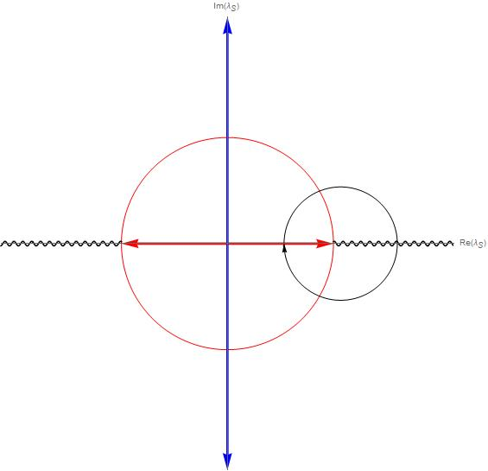
We can deform solutions along closed
contours that cross the real axis outside
the radius of convergence
Need 2 or 4 passes to return to
the same solution
Suggests existence of a branch cut on
the real axis

Slide 32
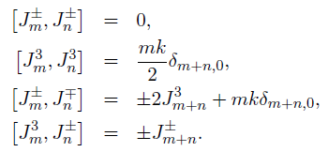
SU(2)_{k} WZW model
SU(2) group elements can be parameterized using 3 angles as
They are generated by 3 operators: J±, J³
In SU(2)_{k} WZW model, the operators are lifted to currents, which have mode algebra

Slide 33


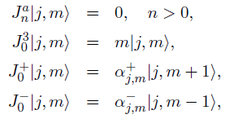
Primary fields are have a structure following irreducible SU(2) representations
  We label them as
  The range of j is restricted by the level k to
  m has the usual range
  The currents act on primary fields as
  Hilbert space is spanned by states

Slide 34
There are two types of boundary states in SU(2)_{k} WZW model
  Maximally symmetric boundary states
  Symmetry-breaking boundary states
We will focus on the maximally symmetric boundary states
They satisfy gluing conditions
which are solved by SU(2) Ishibashi states

Slide 35
Boundary states are labeled by SU(2) group elements g and half-integer J and they are given by the Cardy solution
In OSFT, we impose the following condition
  It implies that solutions preserve the J³ gluing condition
  Only the parameter θ survives
  Its range is now from - to 
  Group elements simplify to

Slide 36
Ellwood invariants
We consider Ellwood invariants given by SU(2) primary operators
and
The expected values are
  Absolute values are given by matrix of boundary state components
  They include complex phase that depends on θ

Slide 37
Cardy solutions
The SU(3) manifold is isomorphic to 3-sphere
D-branes correspond to points or 2-spheres
The condition
fixes rotations of the sphere ⇒ it effectively reduces the 3-sphere to a circle
Results from arXiv: 2112.12213
We found many OSFT solutions describing Cardy branes
  Only finite number of solutions

Slide 38
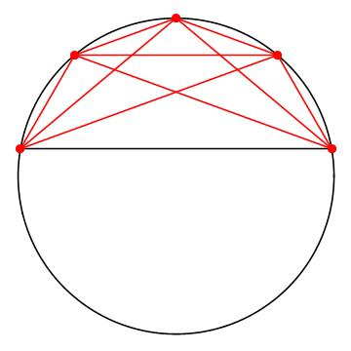
The solutions follow some „selection rules“ regarding their parameters
  The angle θ is related to the difference J_{i}-J_{f}
  Unless J=k/2, branes tend to be on the same
  half of the circle as the initial brane
  Solutions with l=0 touch the original one at one point
  Solutions with nonzero l have worse recision
  The example illustrates this rule for k=9 model with J_{i}=2

Slide 39
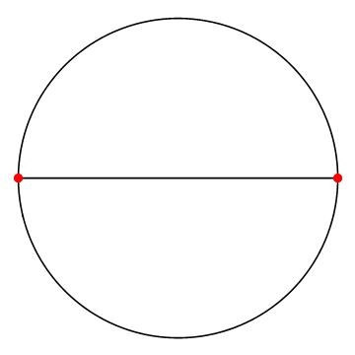
Marginal deformations
Let us consider k=2 model with J=1/2 boundary conditions
There are only two solutions in the usual OSFT approach
How to cover the rest of the moduli space?
We take inspiration from the marginal approach
  Continuous family of solutions parameterized
  by a marginal field
  Marginal deformations of nontrivial solutions
  Analogous to the vacuum branch

Slide 40
There are three marginal fields in SU(2)_{k} WZW model
  Only one survives the condition
We fix the value of and remove the corresponding equation
We look for branch of solutions with for
We divide θ as
θ₀ is the value for the basic solution

Slide 41
We can extract from invariants as
Sometimes provides inconsistent results
Better to seperate invariants into absolute values and complex phases and compute only from the complex phase

Slide 42
0-brane solution in k=2 model
In many aspects similar to the solution in the traditional marginal approach
Lower precision due to more complicated theory and lower available level
There is a branch connected to the basic solution
Has a finite length (endpoint is approximately )
Symmetric with respect to
Consistently describes 0-brane for small
Less precise at small because the basic solution for is not exact
Inconsistent for large
About one half of the branch is off-shell

Slide 43
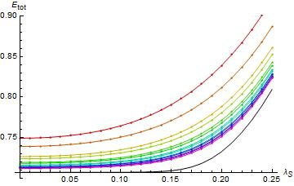
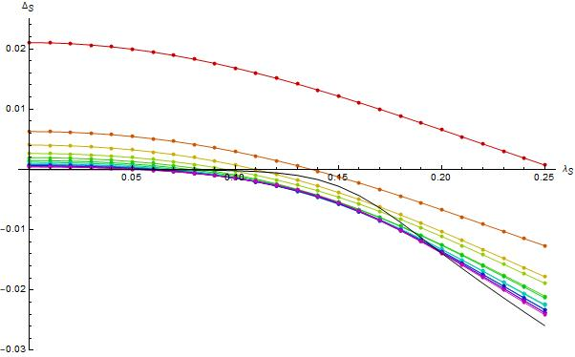
Energy and the first out-of-Siegel equation

Slide 44
Invariant
Should be equal to

Slide 45
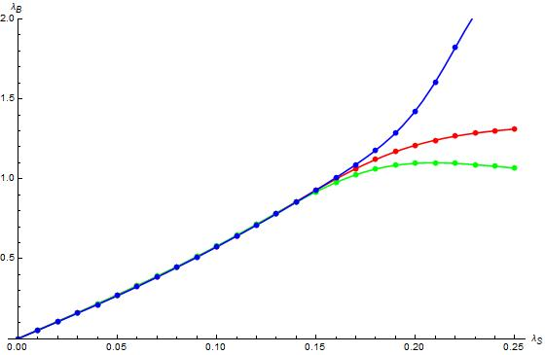
There are three invariants that depend on θ
The values of must be consistent
Holds approximately up to
For example, for we have
  Values agree within numerical precision

Slide 46
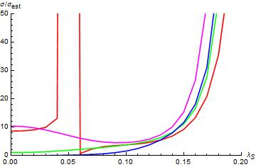
Where the branch goes off-shell?
  Use consistency of
  Use the ratio
We make an educated guess by combining
both approaches
We estimate the endpoint to be
Maximal value of
Should be at least /2 to cover the moduli space

Slide 47
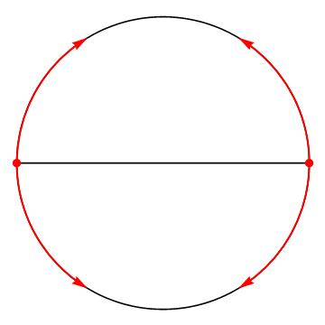
Covers only approximately 63% of the θ moduli space
Corresponds to approximately 92% of SU(2) manifold volume

Slide 48
Most solutions on different background have similar properties
Some solutions are only partially symmetric with respect to
should be symmetric in the infinite level limit

Slide 49
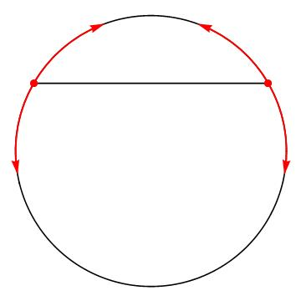
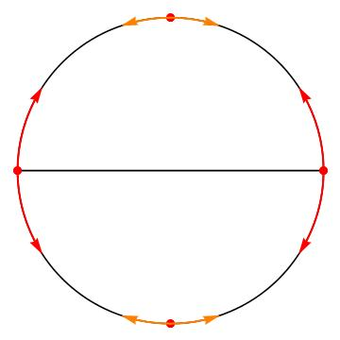
Coverage of 0-brane moduli space for k=3,4 models

Slide 50
Summary of properties of Cardy solutions:
We find continuous families of solutions that describe Cardy boundary states with varying angle θ
They are consistent for small
They go off-shell at some point
On-shell solutions cover only a part of the moduli space

Slide 51
Comparison of λ_{B} for different solutions
We will compare the relation for different models
The square root is added to compensate norm of the marginal field
There is a group of solutions (mostly 0-branes) with similar relation between the marginal parameters until they go off-shell
We conjecture that there are groups of solutions that have the same first coefficient in the expansion of
They may possibly share the entire function

Slide 52
Red, green, blue: 0-branes
Yellow: Badly convergent 0-brane
Magenta: ½-brane
Orange: B-brane

Slide 53
B-brane
This approach can be also applied on symmetry-breaking boundary states
Example: k=3 B-brane solution with J=0
The whole branch is probably on-shell
Most observables should be 0 or constant
Only one invariant ( ) depends nontrivially on the marginal parameter
Its absolute value is almost constant
Complex phase changes
The results suggest that its exact value is

Slide 54
We choose the coefficient in the exponential to be 3/2
Then matches the results for 0-brane solutions

